Slide 1

Welcome to Team Alpha Analyzer

Slide 2
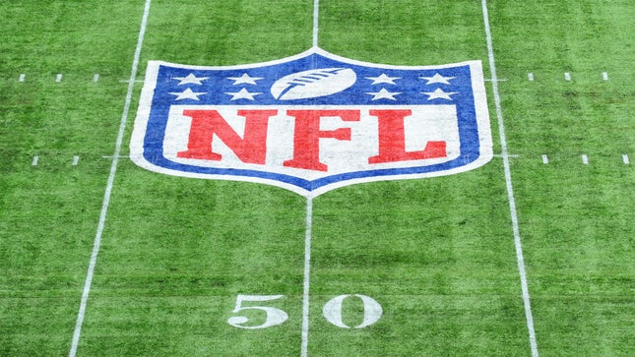
Group 2:
Bajineni Ashok Archana Kumari
Choksi Mrudul
Edulakanti Srinivas
Elahi Adnan

Slide 3
Abstract
Data and analytics have been part of the sports industry from many years. However it is only recently advanced techniques like Hadoop, hive and many tools are utilized for facilitating the operations of sports franchises. while part of the reason is related with ability to collect more filtered data an equal important factor for the team and the associations to analyze about the playing turf. Different association and people associated with the teams, sports clubs and other stakeholders in the industry invest in analytics.

Slide 4
Abstract Contin….
we are excited to analyze a NFL game as the datasets and variables are available to examine the effects of playing the game on synthetic turf versus natural turf to understand how the player moves on the field and the factors that results in low extremity injuries. These files have data about injuries, player plays and player movement during the game.

Slide 5
Data Set
https://www.kaggle.com/zinovadr/trained-nfl-data-ready-for-analysis#predLBInv.csv
Data Set size 9 GB

Slide 6
NFL Game Background
In Gridiron football there are 11 players from each side
Purpose of game is to move the ball to the opposition’s end zone that is either the person holding the ball should run or pass the ball to the other teammates until the ball is moved to end zone.
Player positions on the field
Defensive Back
Line Backers
Wide receiver

Slide 7
Position Type:
Defensive Backs
Who take positions somewhat back from the line of scrimmage, they are distinguished from the defensive line players and line backers and who take positions directly behind or close to the line of scrimmage.
Linebacker
Linebackers are members of defensive team and they are approximately 3 to 5 yards behind the line of scrimmage behind the defensive lineman, therefore back up the line. Linebackers generally align themselves be snapped by standing upright in a two-point stance.

Slide 8
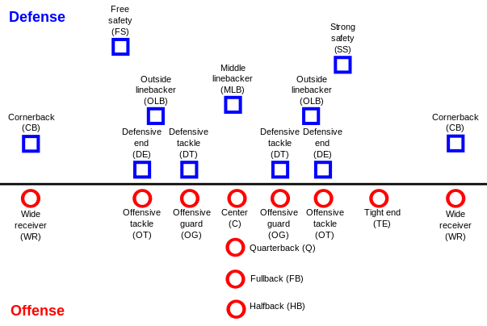
Position Type:
Wide receiver
This is an offensive position in gridiron football and is a key player. They get their name because they are split out wide farthest away from the rest of the team. Wide receivers are fastest players on the field.

Slide 9
System Specification
Cluster version : Hadoop 2.7.1.2.4.2.0-258
Cluster size : 1003.6 GB
Cluster Number of Nodes: 3 (1 Master Node 2 Slave Nodes)
Number of Processors: 32
Memory: 241.821 GB
CPU Model Name : Intel(R) Xeon(R) CPU E5-2699C v4 @ 2.20GHz
CPU Speed : 2.20GHz
Hive version: Apache Hive version 1.2.1000.2.4.2.0-258

Slide 10


Flow Chart of Project
Connect to Oracle BCDE account using SSH command line interface to store and analyze data
Download data from Kaggle.com
Uploaded.csv file from local system to HDFS system using SCP command
Creating Visualization using Tableau by creating bar graphs and other charts
Creating external tables and analyzing information by using SQL commands
Connecting the Data to Beeline by giving password

Slide 11

Analysis using Visualizations

Slide 12
In the below visualization we have analyzed the NFL data to find out two important attributes.
One being the field type and the other being the injuries caused in defensive back position type
We could see the number of injuries on natural type are more when compare to Synthetic type.
Injuries to knee are more than injuries to Ankle on Natural field.

Slide 13
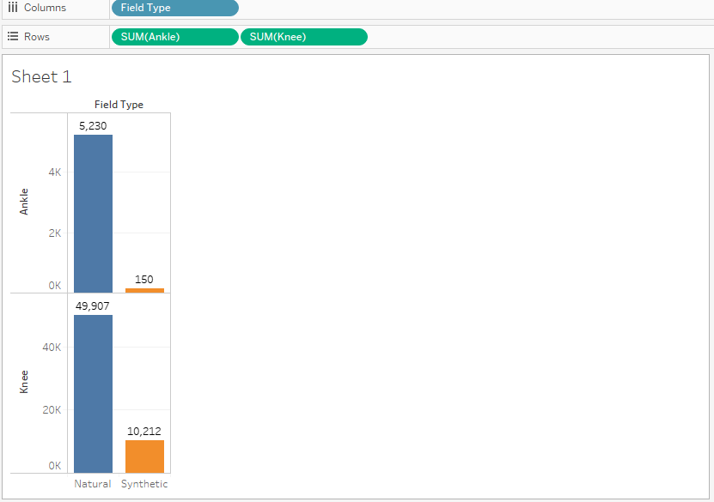

Slide 14
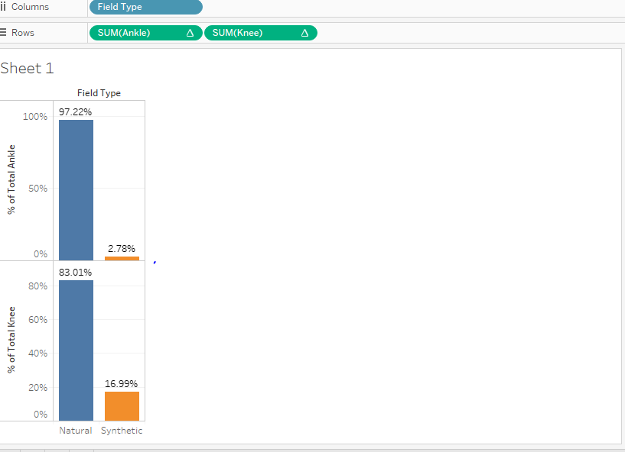
Comparison
Percentage of injury to Ankle is 97% on Natural Turf which is quite high when compared to percent of injury to Ankle on Synthetic
Percentage of injury to knee is 83% more on natural compared to synthetic turf
If you observe the percentage of knee injuries on synthetic are more than the percentage of Ankle injuries on synthetic Turf.

Slide 15
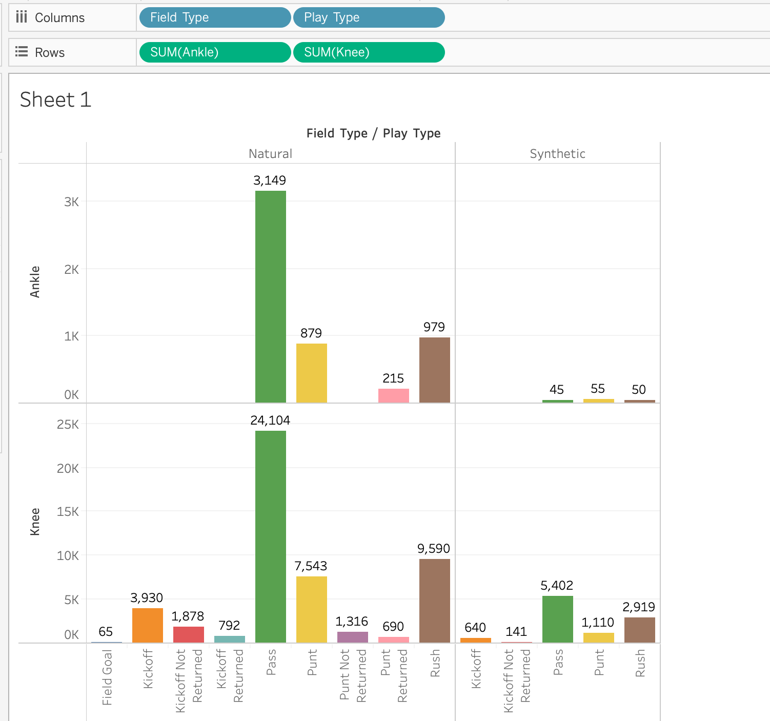
Natural vs. Synthetic Field

Slide 16
Natural vs. Synthetic Field
In the above table we have taken field type, Play type and the injury to knee and ankle figures to analyze the number of injuries in particular play type on natural and synthetic ground.
From the above table we can clearly see that injuries to players have caused by play type “pass” are more on natural turf.
While on synthetic turf the number of injuries to knee are more while pass play type
Injuries to body part Ankle are more on synthetic turf while play type is Punt

Slide 17
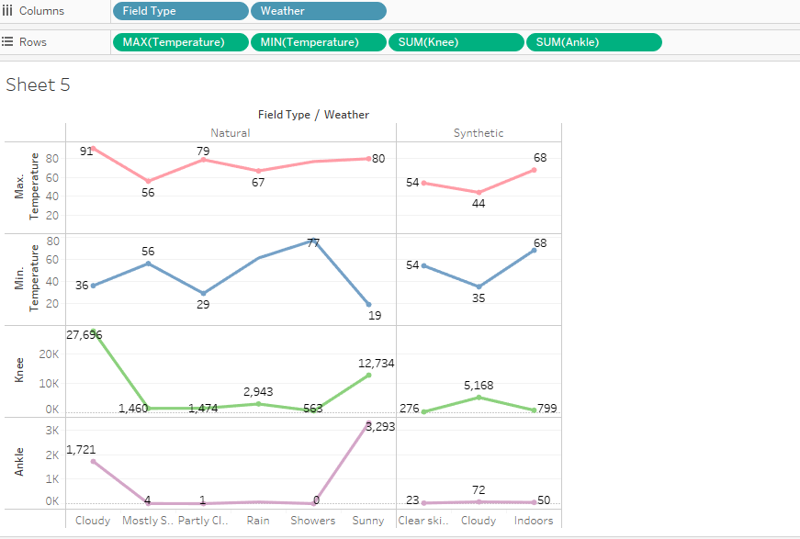
Weather Conditions vs. Injuries

Slide 18
Weather Conditions vs. Injuries
The above visualization has field_type, weather and the number of injury fields.
Reason for using these attributes is to analyze the max temperature and min temperatures and the type of weather results in a greater number of injuries on both Turfs.

Slide 19
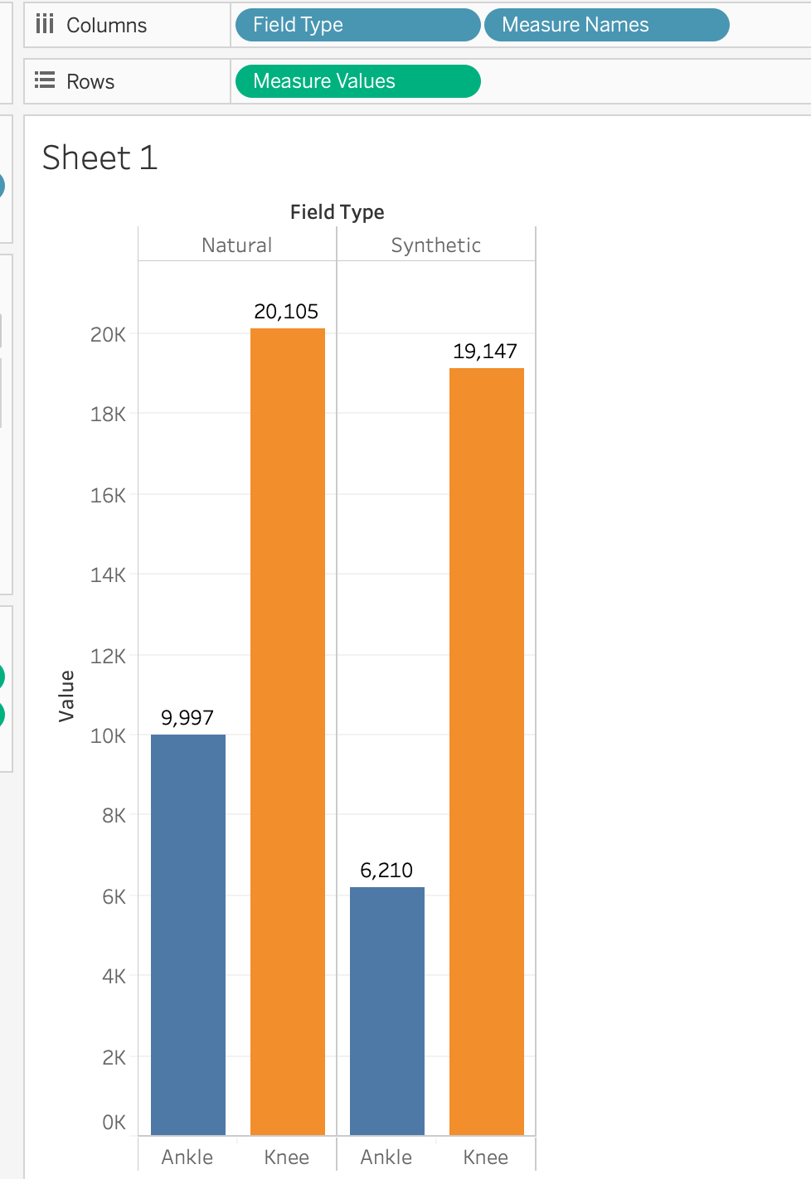
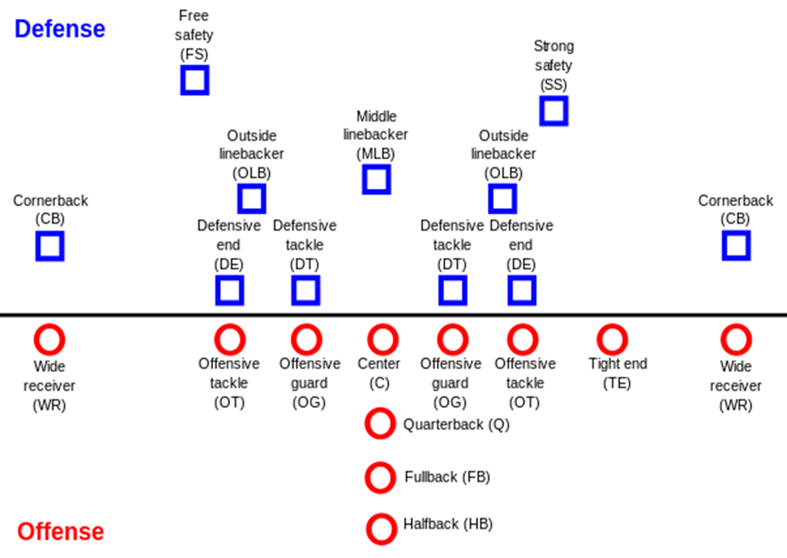
Line Backer Analysis

Slide 20
We have analysis for the linebackers on both field types
On the overall we could see the number of injuries on the natural field type are more as usual.
Two important things we analyzed from the above visualization is there is not much gap between injury figures in both field types.
The other being when you compare the figures between the defensive and line backer you will see injuries for line back position are more.

Slide 21
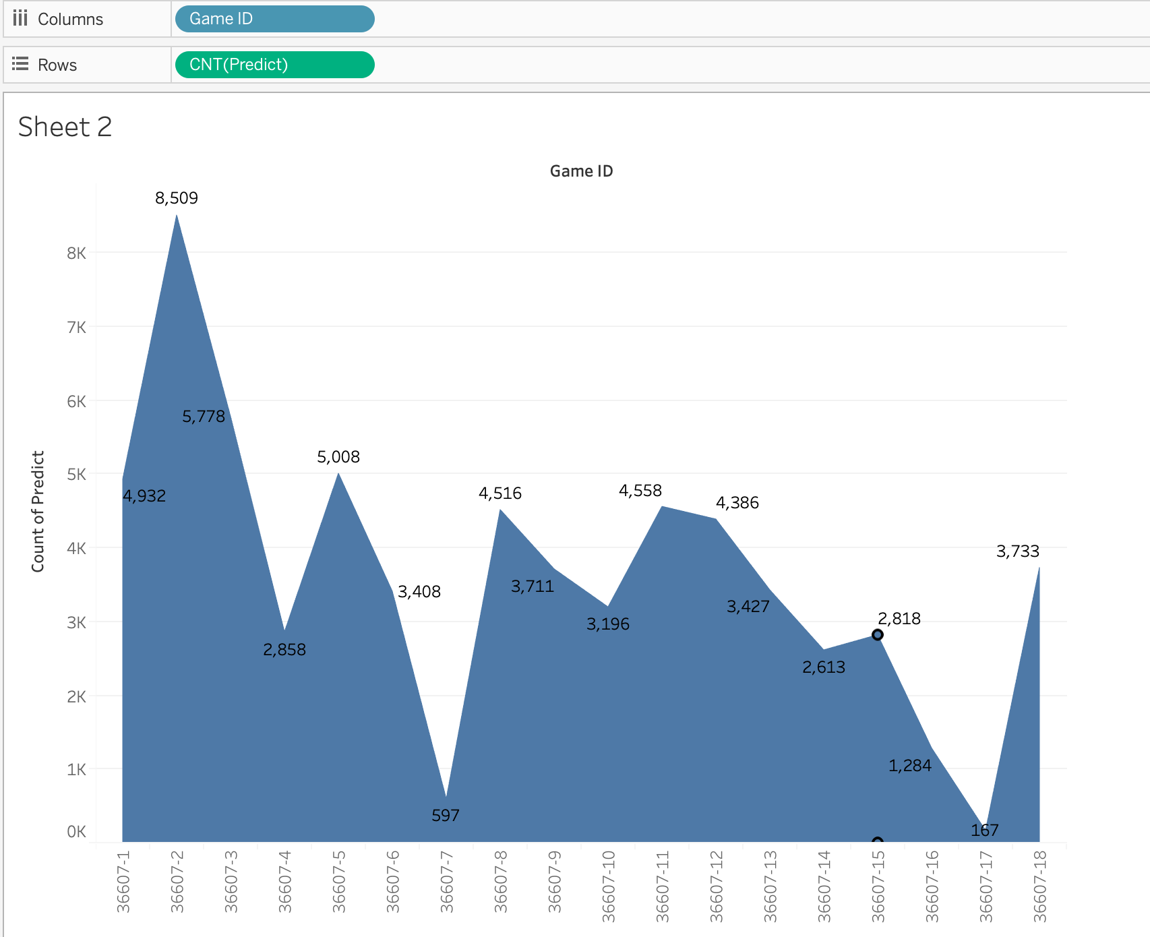
Game Identifier with injuries - PredLB

Slide 22
Game Identifier with injuries - PredLB
The above visualization was performed to analyze the injuries as per Game Id
Two types of variables are used to arrive at the decision Game Id and predict Column
Number of Injuries for Game Id 36607-2 is highest and the number of injuries for Game Id 36607-17 is lowest

Slide 23
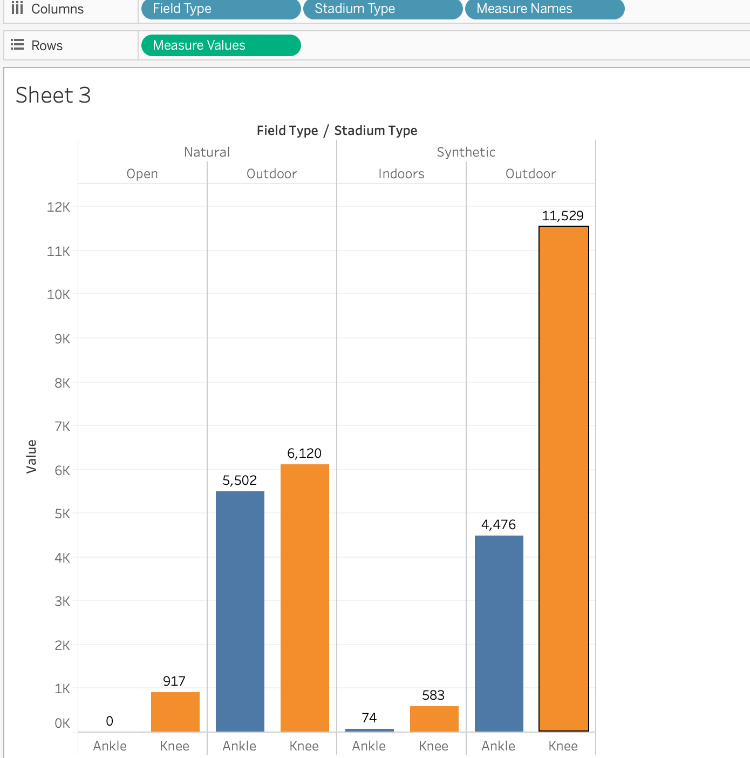

Wide Receiver Analysis

Slide 24
Wide Receiver Analysis
We have used field type, stadium type and the amount of injuries to identify the number of injuries in indoors and outdoors.
The number of knee injuries on synthetic floor in outside stadium are more when compared to natural field type.
Knee injuries are higher in all three types of positions types.

Slide 25
Conclusion:
This project was taken to analyze to see the number of injuries in particular type of position, field type , stadium type because we wanted to identify most least preferred ground types .The reason being the investors and sponsors would spend so much of money on players well being and the profit would be maximized only when the important players play matches without missing. We came to conclusion to advise investors , stakeholders, sponsors, players and fans is playing on synthetic field will result in less number of injuries .

Slide 26
Questions and Answers
Thank you

